Slide 1
Integrating CORTX metrics to Promethus for monitoring purposes
Hackathon 7-10.12/2020
Participants:
Koren Lev (Mentor)
Yaron Yogev
Yoni Oranim
Rotem Beach

Slide 2
Concept Details
Our integration is between CORTX and Prometheus, which is an open source monitoring system with a dimensional data model, flexible query language, efficient time series database and modern alerting approach. More info about it is at https://prometheus.io/
For collecting metrics from CORTX to Prometheus, we will use Telegraf, which is an open source plugin-driven server agent. More info about it is at https://github.com/telegraf/telegraf/blob/develop/readme.md
For viewing purposes, we will use Grafana, which is an open source analytics and interactive visualization web application. More info about it is at https://grafana.com/
The reason we chose Prometheus is it has an active community of open source developers. We’d like to integrate it with CORTX to achieve better monitoring capabilities than the current CORTX UI.

Slide 3
Concept Details
Let’s take autonomous cars as a use case example: A fleet of cars, each storing a CORTX machine, can be monitored with a single Linux server running Prometheus and Grafana.As part of the integration, we created a telegraf input plugin for s3 api in CORTX.
The purpose of the plugin is to pull out data metrics (For example, object counts, object types and folders).
The output of the system is nicely shown in Grafana UI.

Slide 4
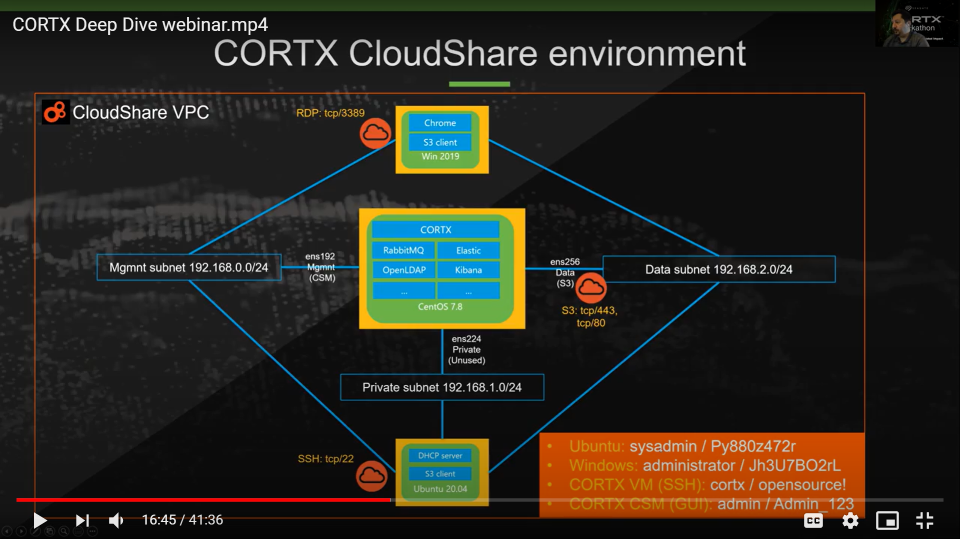
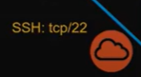
OS: Ubuntu20.04
S3 client
Prometheus server http:9090
Grafana server http:3000
DHCP server

